Slide 1

Signal Processing
PROJECT PRESENTATION
Contributions
Radheshyam-Part-1
Eswar Kumar-Part -2
Nithin Part-3

Slide 2
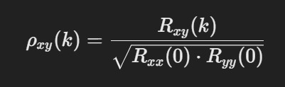
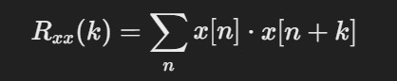
PART-1 : Bird recognition
PRIMARILY USED CORRELATION

Slide 3
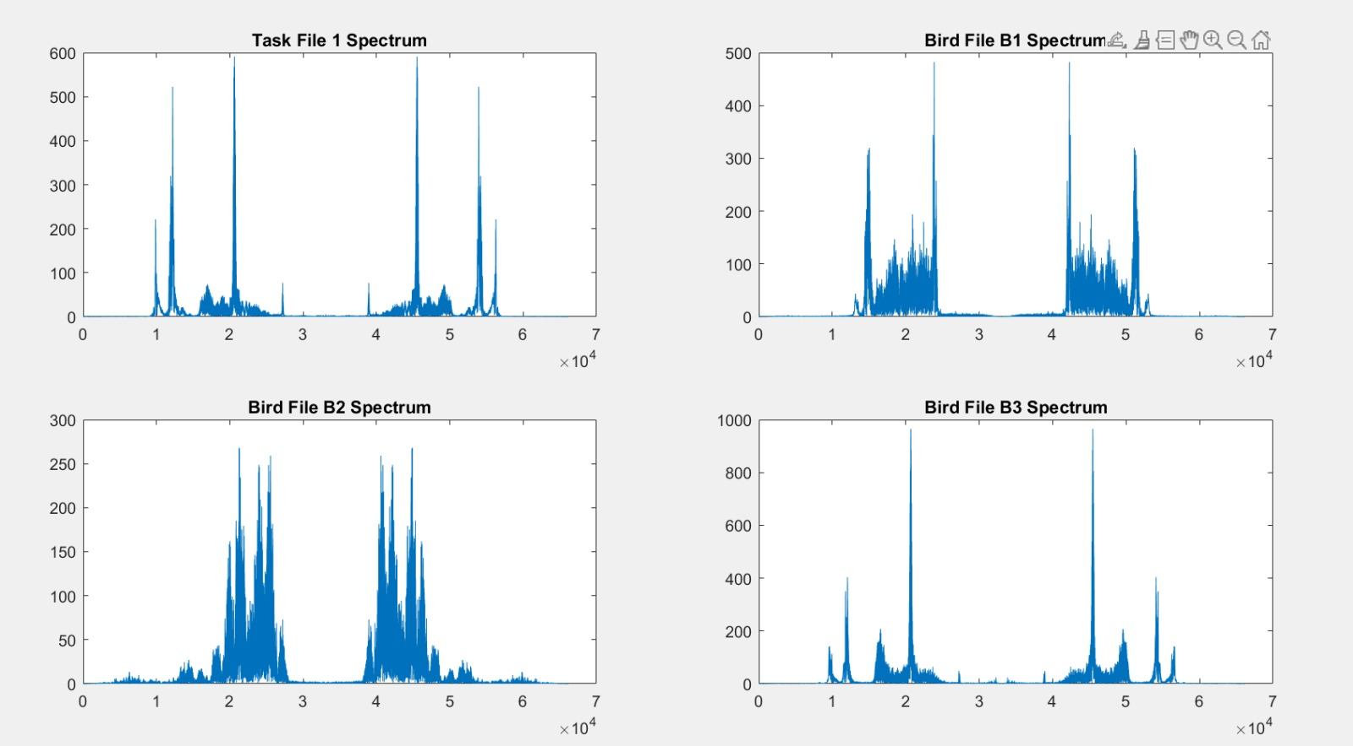

Slide 4
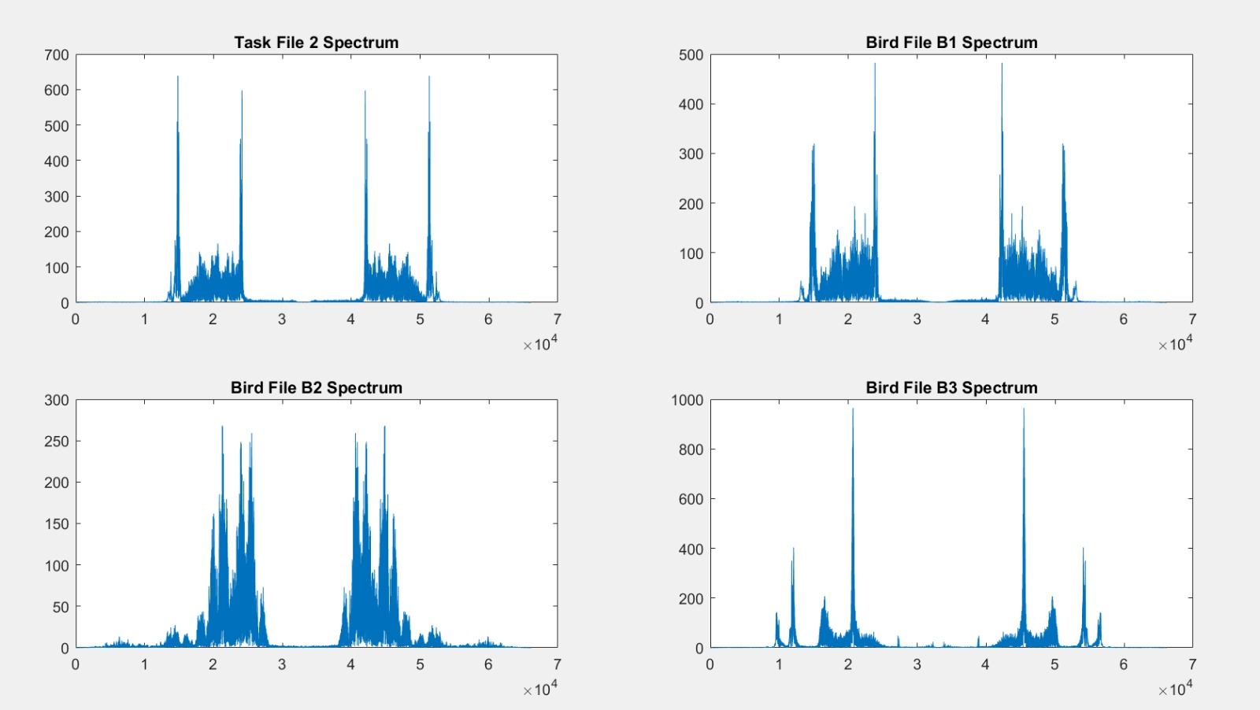

Slide 5
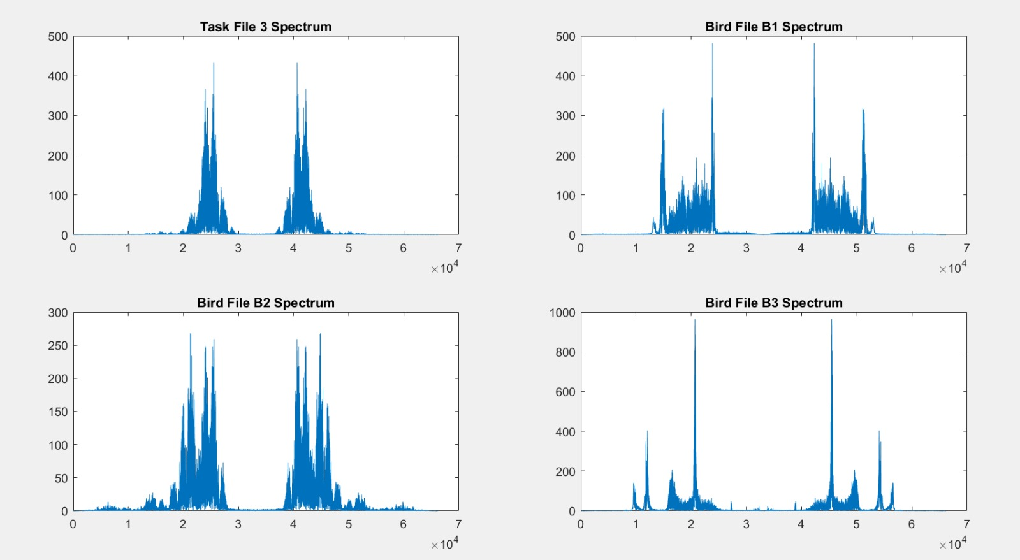

Slide 6


Slide 7
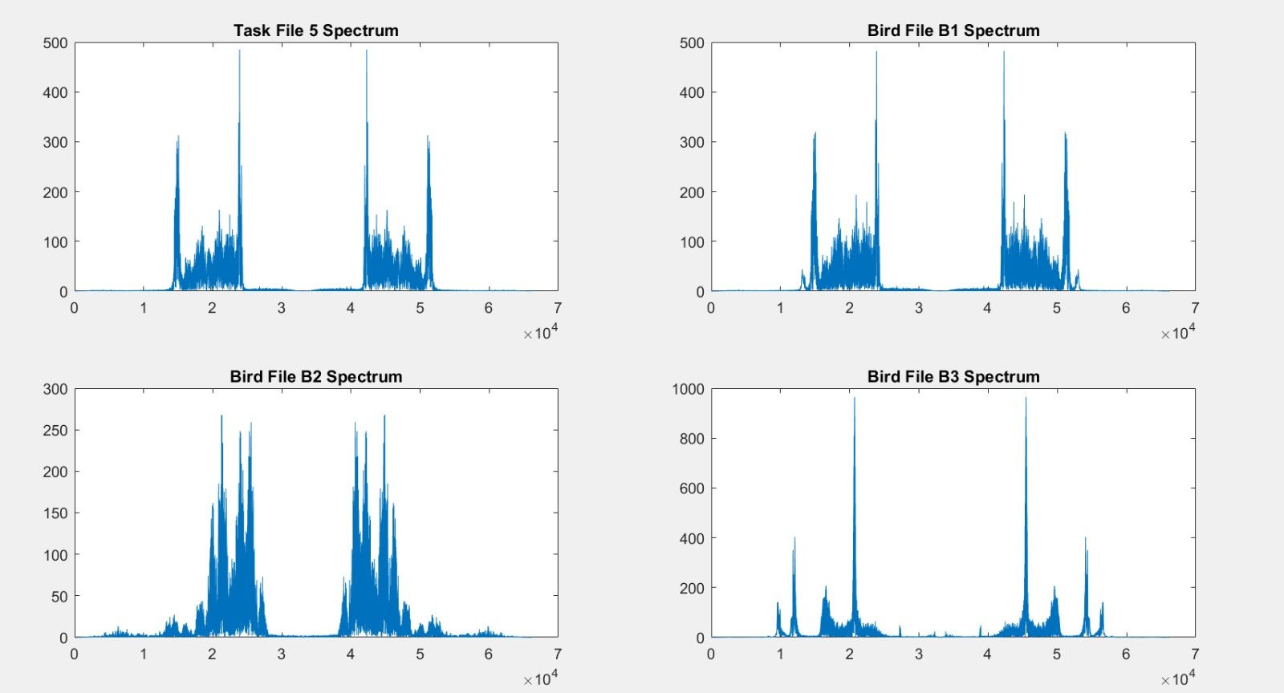

Slide 8
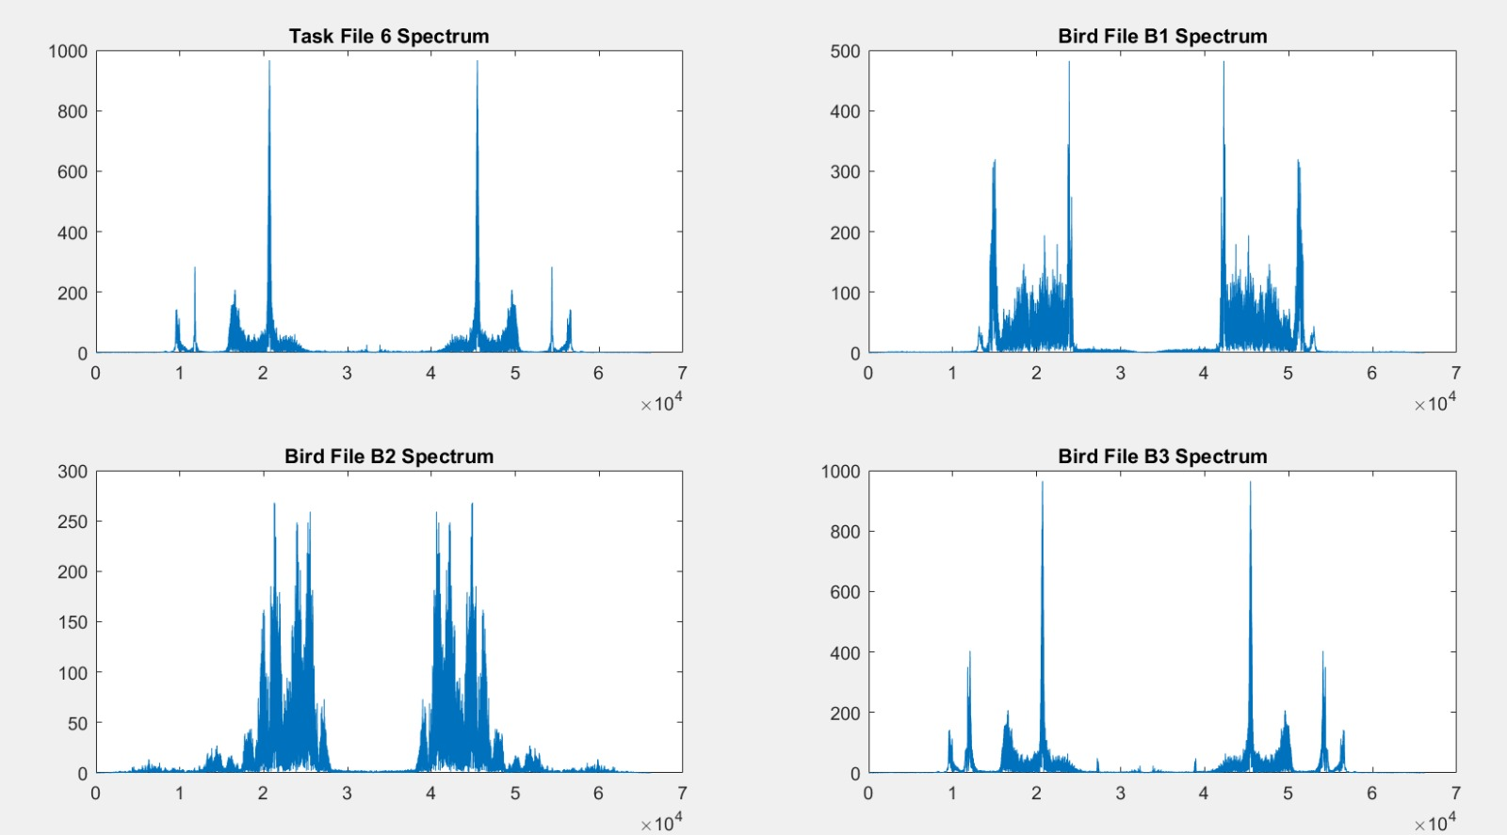

Slide 9
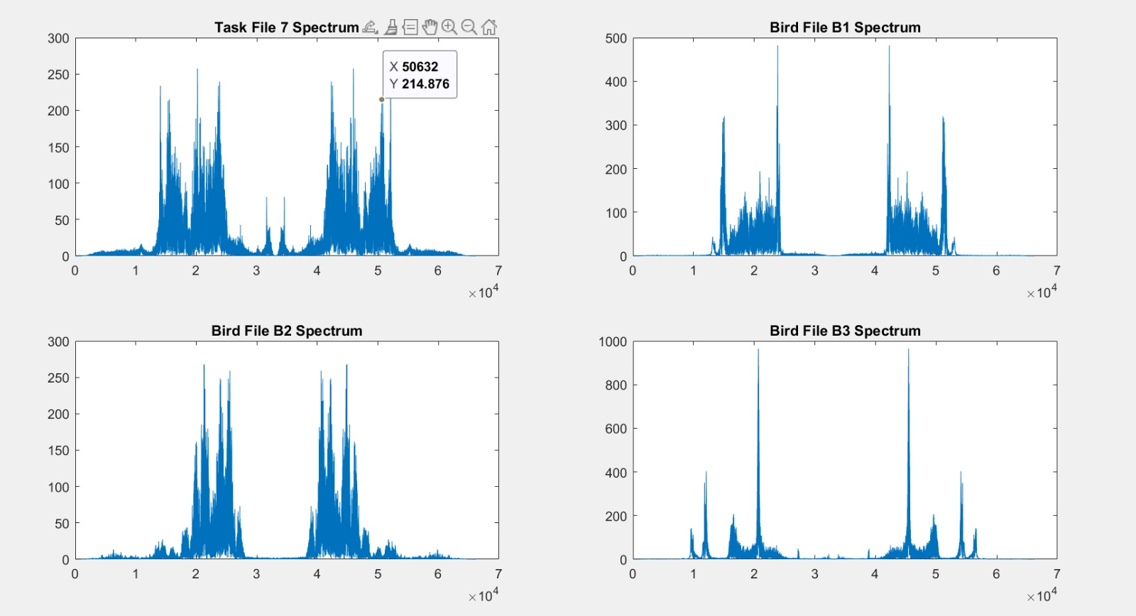

Slide 10
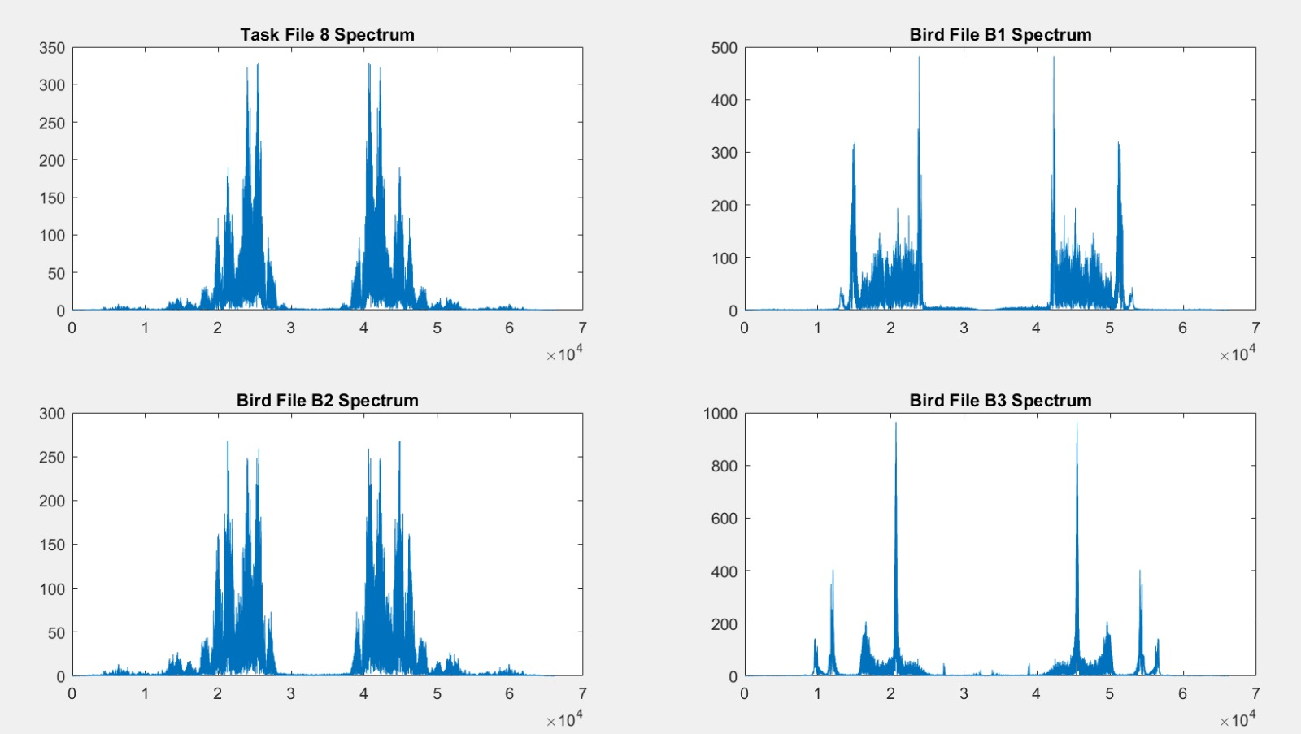

Slide 12
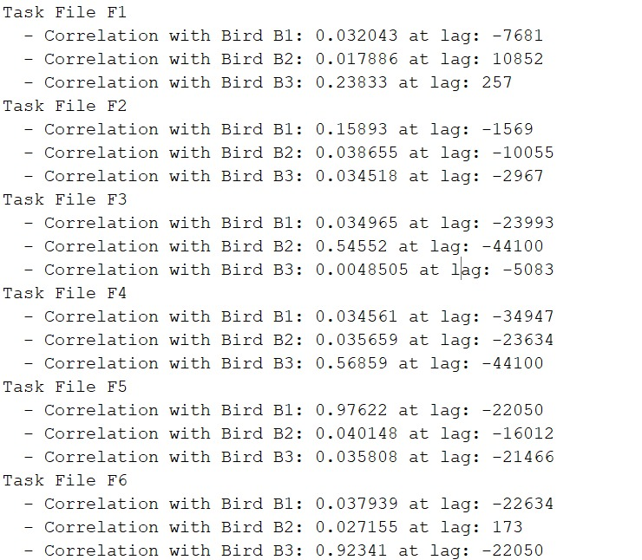
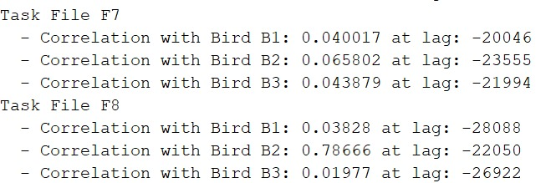

Slide 13
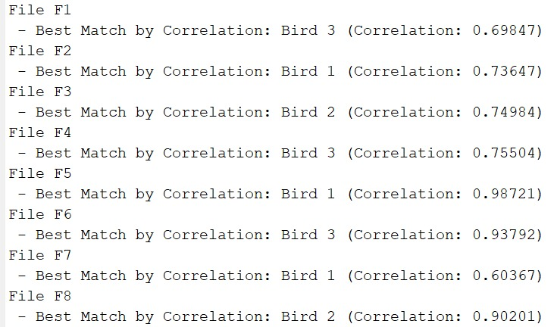

Slide 14
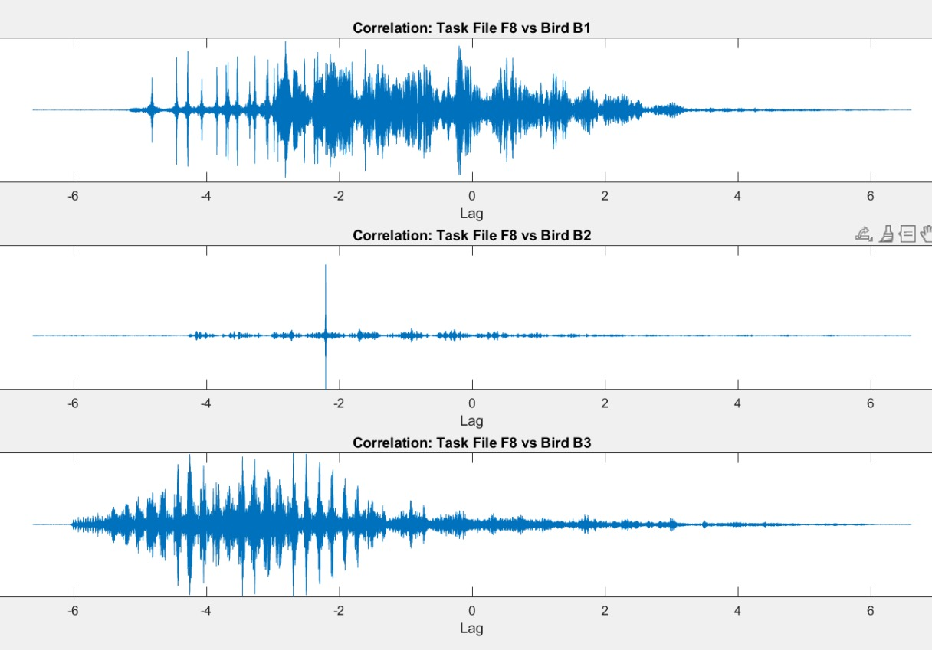
TIME CORRELATION

Slide 15
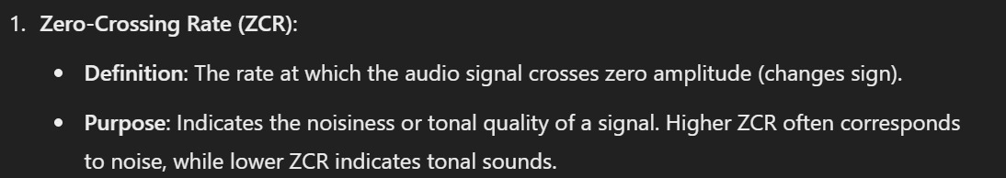
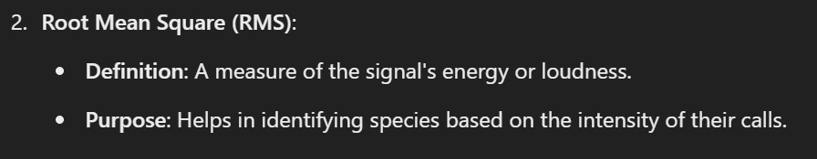
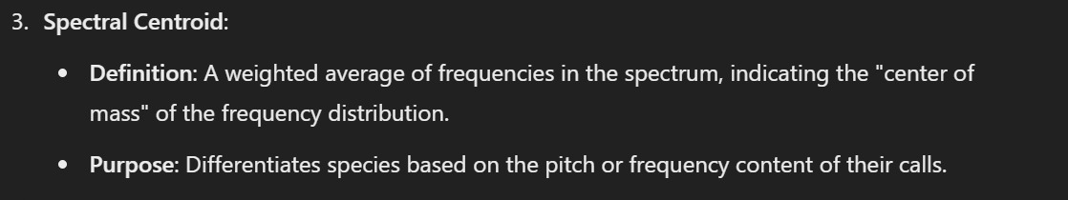

Slide 16
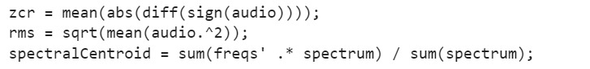
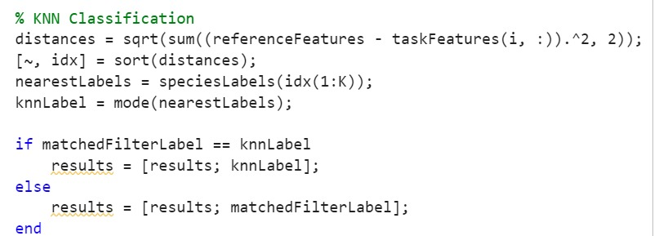

Slide 17
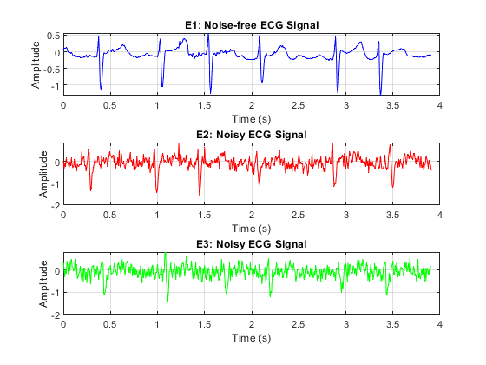
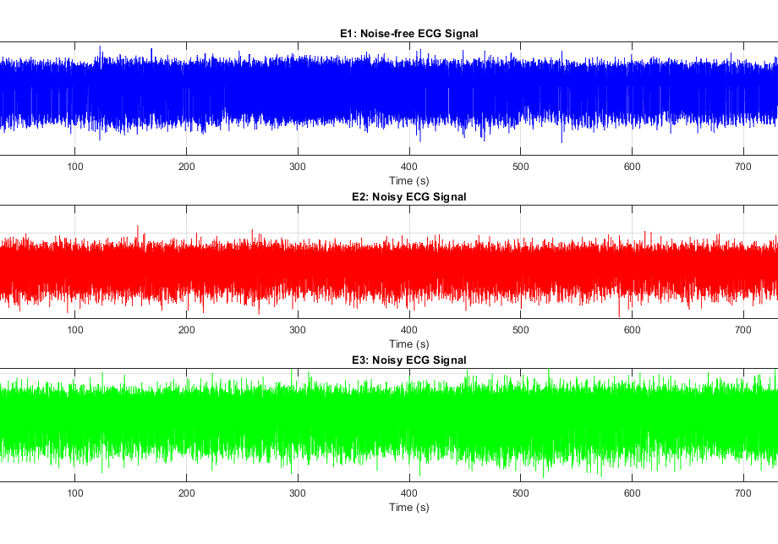
Part 2: Heart rate estimation TASK-1
Given 3 signals one with noise free and another 2 with noise with sampling rate is 128/s .Our task is to find the the heart rate of 3 signals

Slide 18
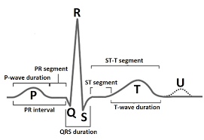
Pan-Tompkins Algorithm

Slide 19
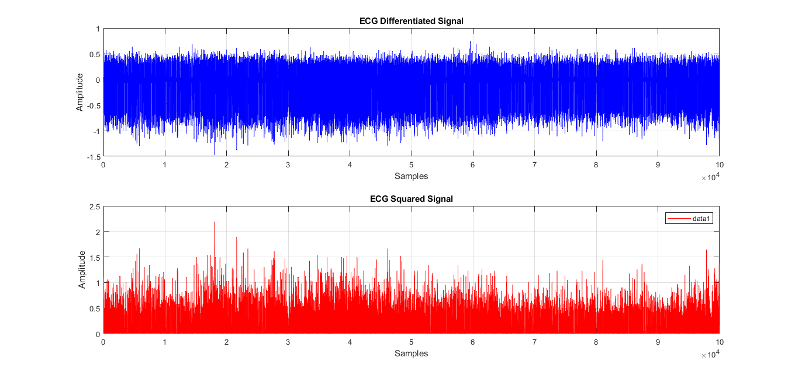
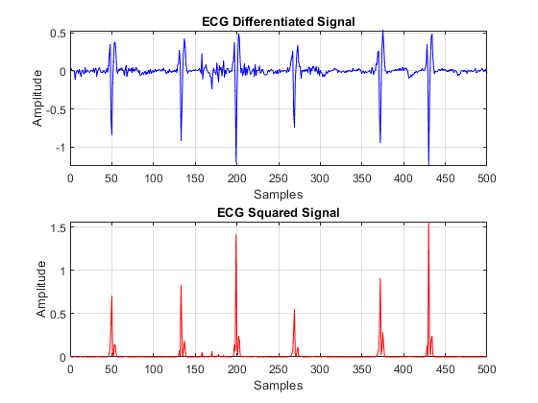
E1 difference and it’s squared signal
Why difference and squaring it ..??
Difference:
Detects quick changes in the ECG, focusing on the sharp slopes of the QRS complex and reducing slower parts like P and T waves..
Squaring:
Makes all values positive, highlights large peaks like QRS, and reduces small changes or noise.

Slide 20
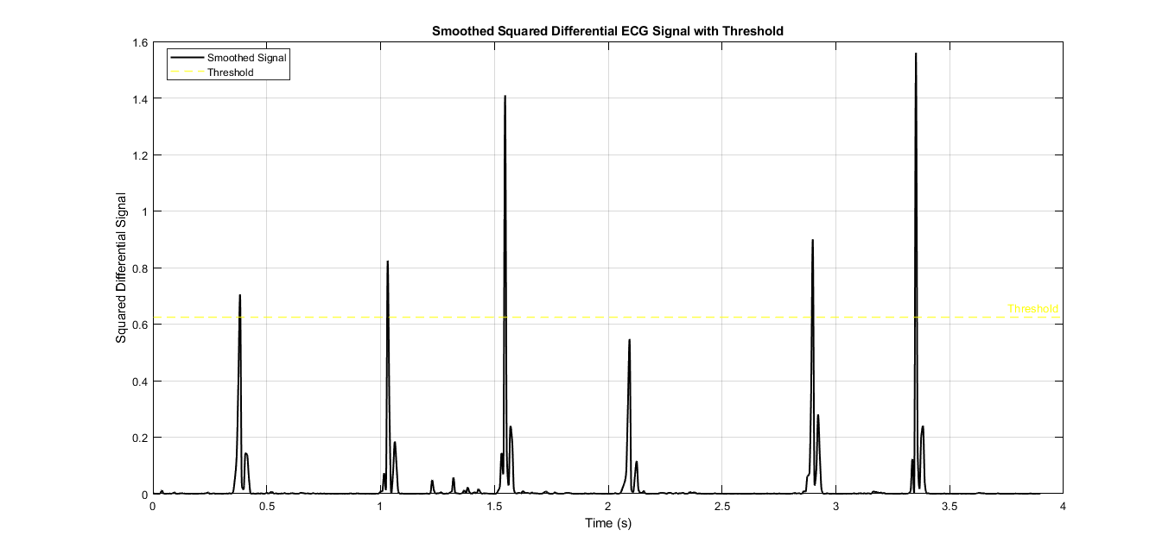
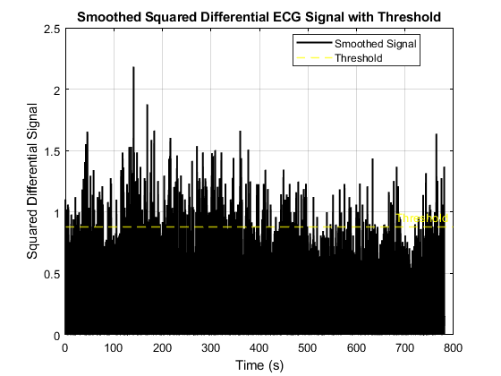
Smoothing the Signal
Thresholding: Detects peaks like the R-wave by ignoring small fluctuations and noise, ensuring accurate identification of important features.
Windowing: Smoothens the squared signal and highlights the QRS complex by collecting energy over a short time.
Thresholding: Detects peaks like the R-wave by ignoring small fluctuations and noise, ensuring accurate identification of important features.

Slide 21
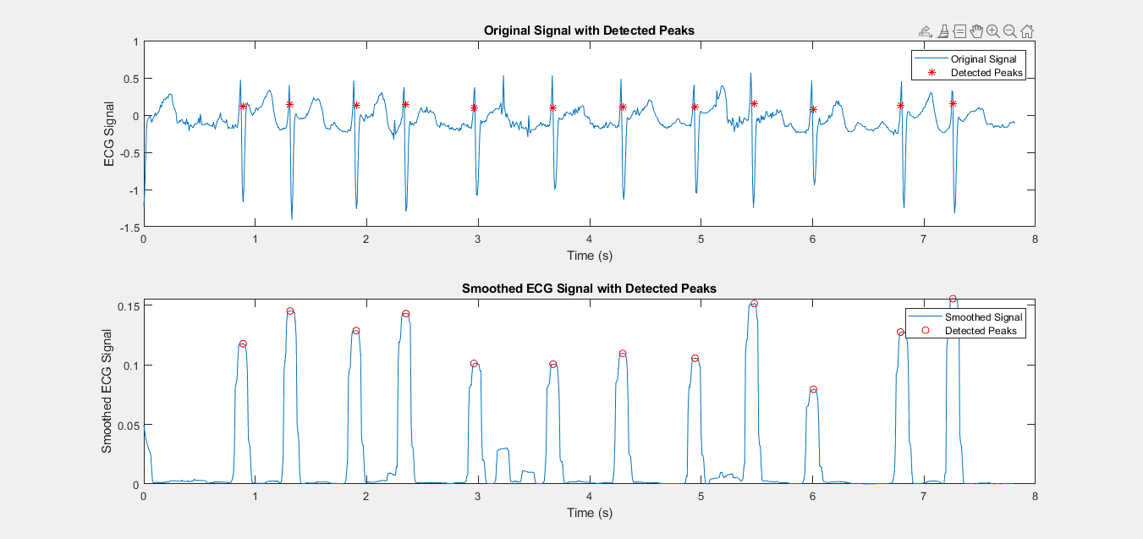
PEAK DETECTION
Let’s compare original signal and smoothed signal peak detection with given threshold (40% of the maximum squared differential signal)

Slide 22
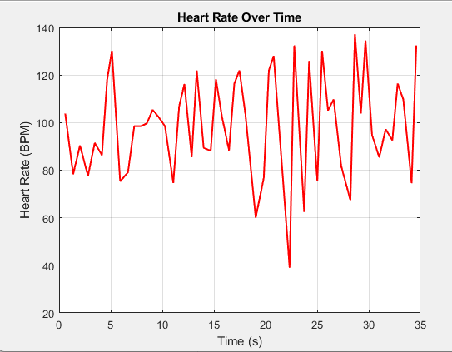
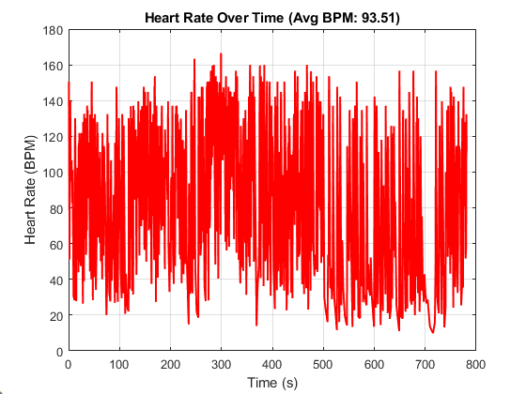
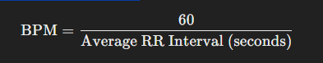
BPM
Calculate the time difference between consecutive R-peaks in seconds. These are called RR intervals
.
The heart rate in BPM is the reciprocal of the average RR interval in seconds, multiplied by 60 (to convert from seconds to minutes):

Slide 23
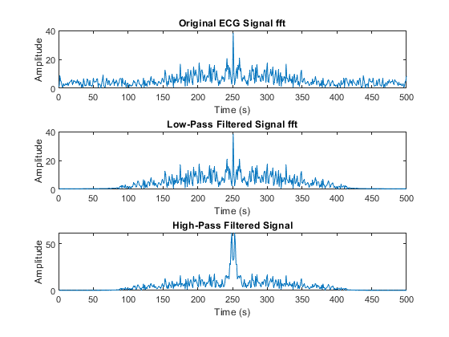
Noise cancellation of e2 signal TASK-2
As we are calculated before for E1 signal we just use other step for E2 and E3 signals to remove noise .We use Low pass and High pass filter(Cascaded) with cut off frequency 40 and 0.5 respectively.this is called band pass filter

Slide 24
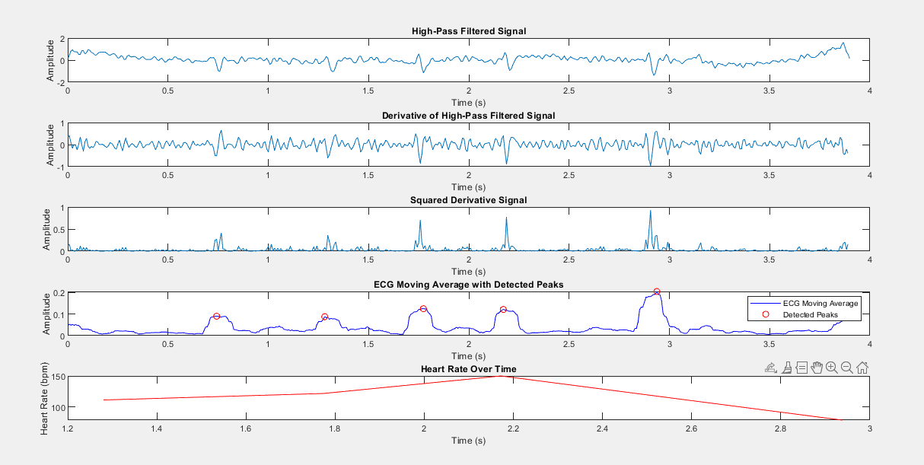

Slide 25
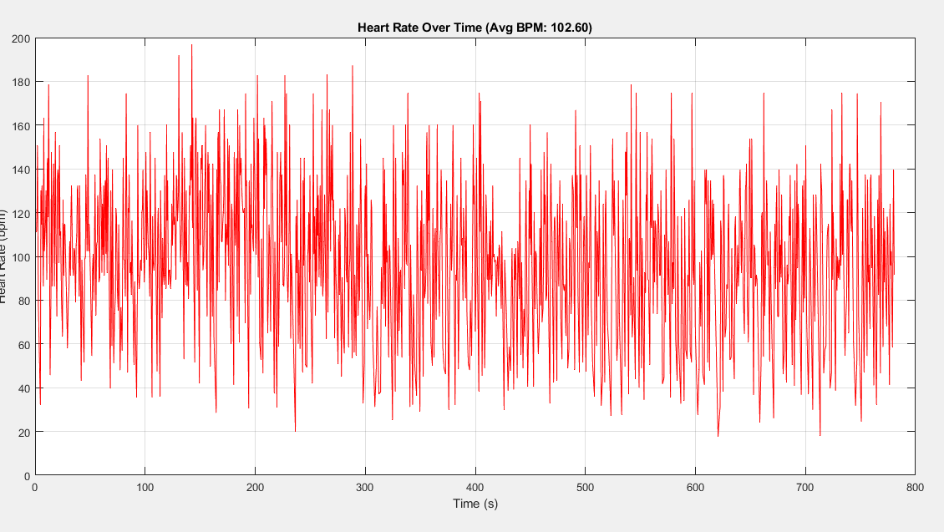
BPM AVERAGE
Average bpm is 102.6

Slide 26
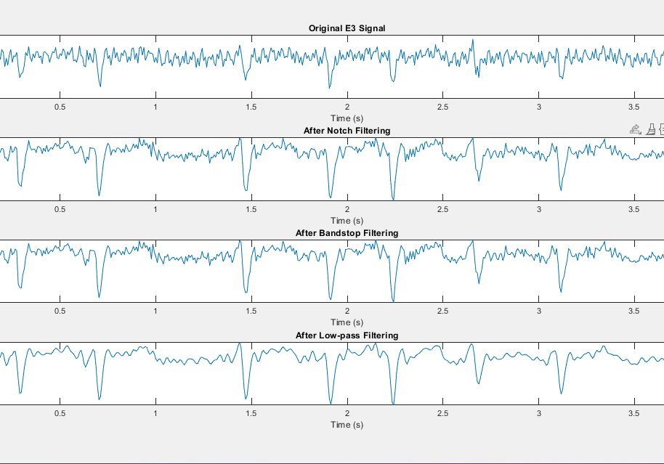
E3 SIGNAL NOISE CANCELLATION
Here we use another method to remove noise.First we apply notch filtering (with frequencies [22,50] and band width of 0.1).Then bandstop filter with fc_low_s =21 and fc_high_s = 23 to remove additional noise and finally a low pass filter to smooth the signal

Slide 27
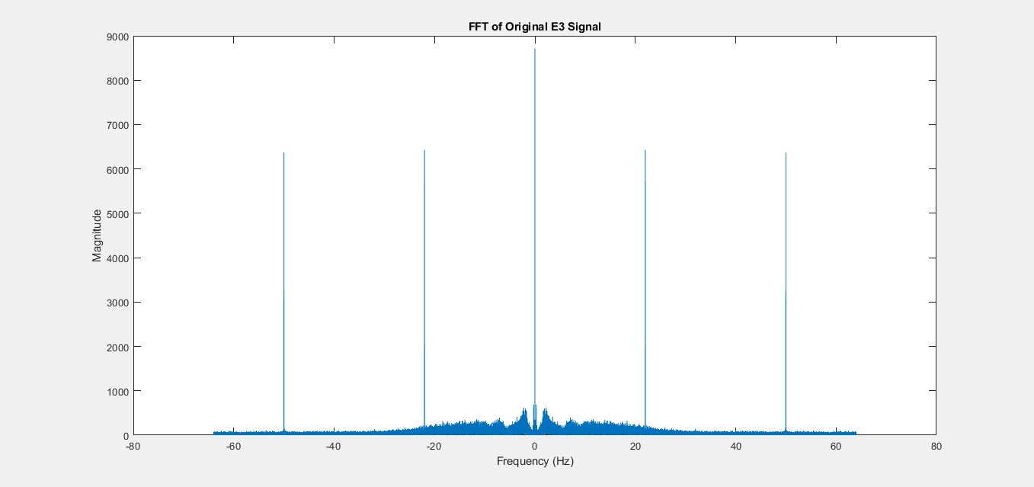
WHY THIS MEthod
We get additional frequencies at 22-50.To remove this we use this method

Slide 28
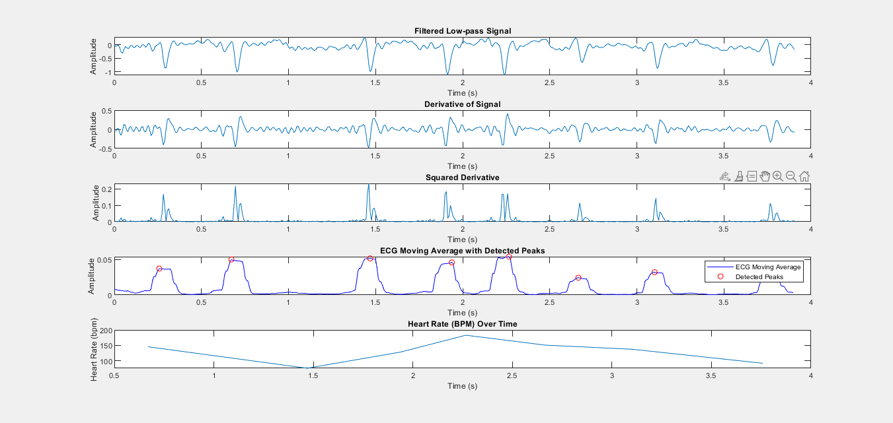

Slide 29
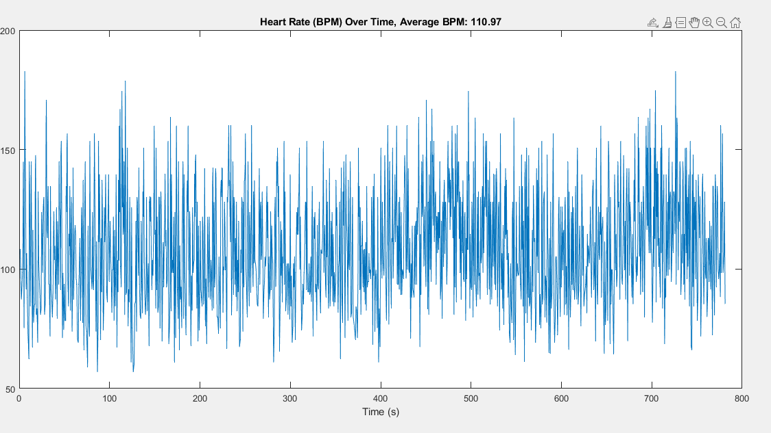
BPM AVERAGE
110.97

Slide 30
Part 3: Loudness segmentation Task-1
Detect loud audio segments automatically using statistical thresholds.
Visualize and analyze segment-level amplitude metrics.
Playback detected loud segments for validation.

Slide 31
PROCESS
Preprocessing:
Load audio and text data. Convert stereo to mono if necessary.
Segment Extraction:
Map time ranges to audio samples.
Amplitude Metrics Calculation:
Mean, RMS, sqrt mean, max amplitude.
Loudness Detection:
Use statistical thresholds to identify loud segments
Visualization and Playback:
Highlight loud segments on waveform And play them

Slide 32
Loudness Detection
Thresholds set using percentiles:
79th percentile for max amplitude.
78.57th percentile for RMS.
A segment is marked loud if:
Max amplitude ≥ threshold OR
RMS ≥ threshold.

Slide 33
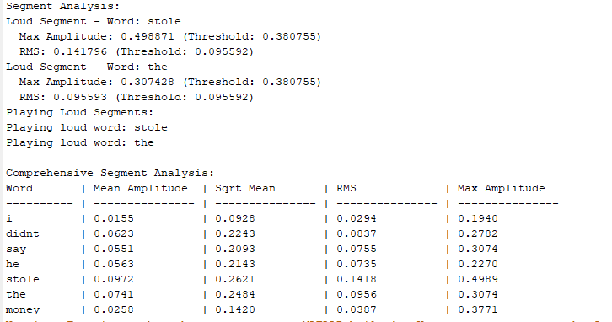
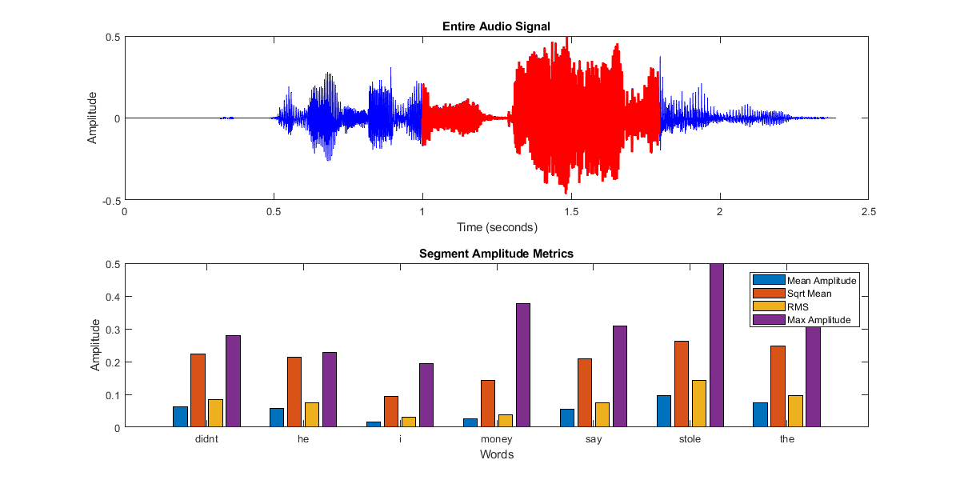
Segment Metrics Visualization
Bar chart comparing:
Mean Amplitude.
Sqrt Mean
RMS.
Max Amplitude.

Slide 34
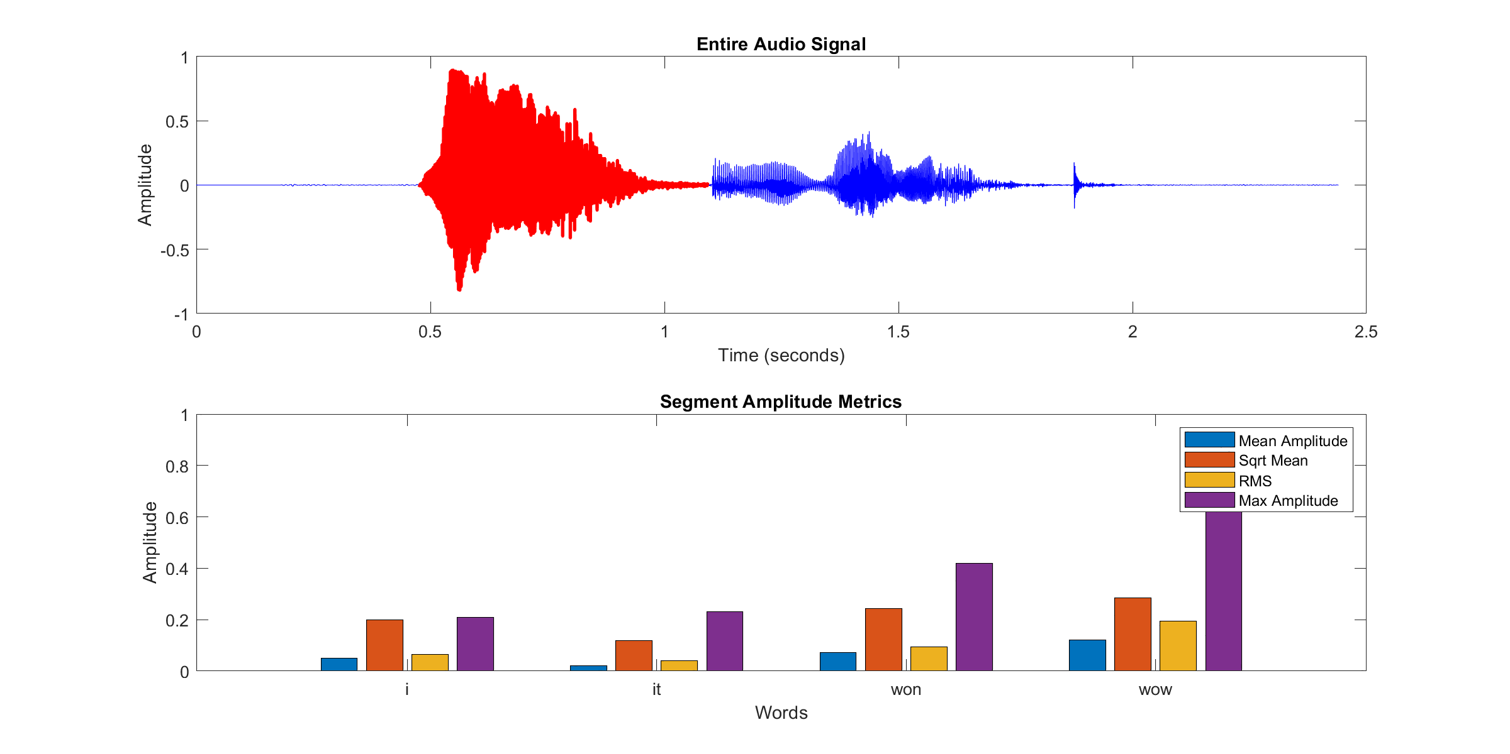
Loud Segment Playback
Loud segments were played for validation.
Observations:
Matches identified loudness visually.
Ensures thresholds are accurate.

Slide 35
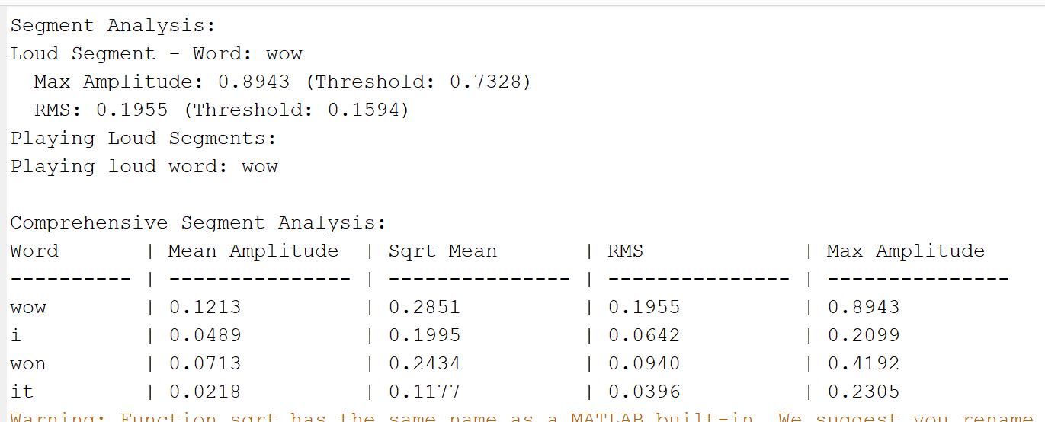

Slide 36
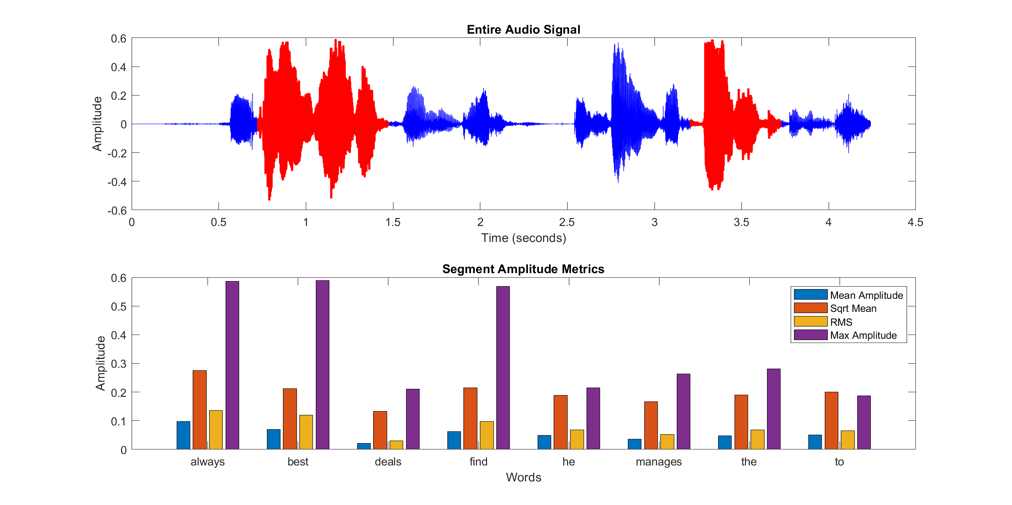

Slide 37
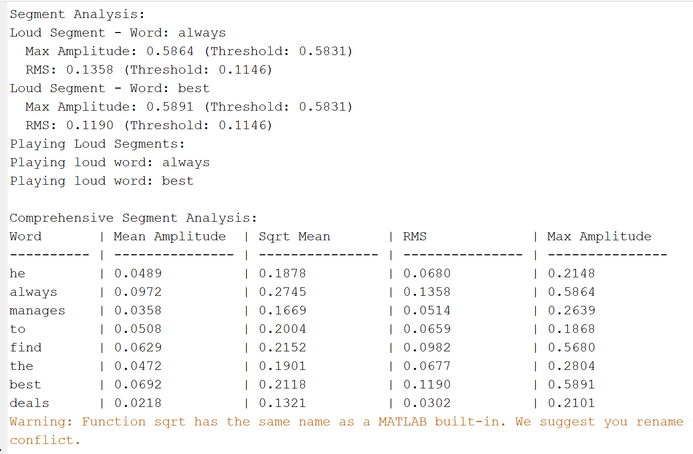

Slide 38
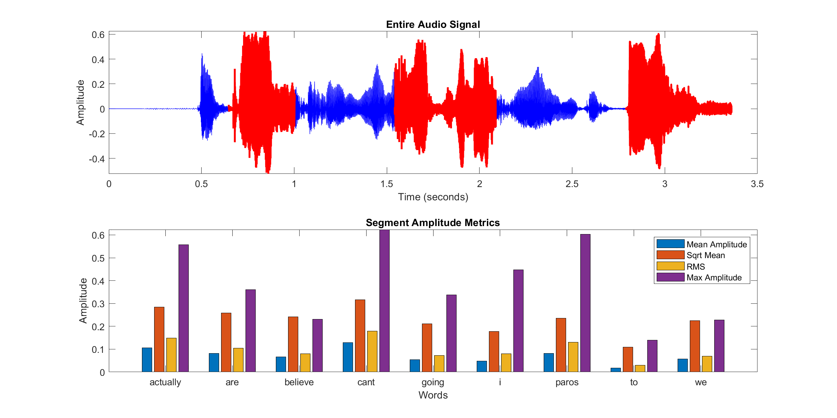

Slide 39
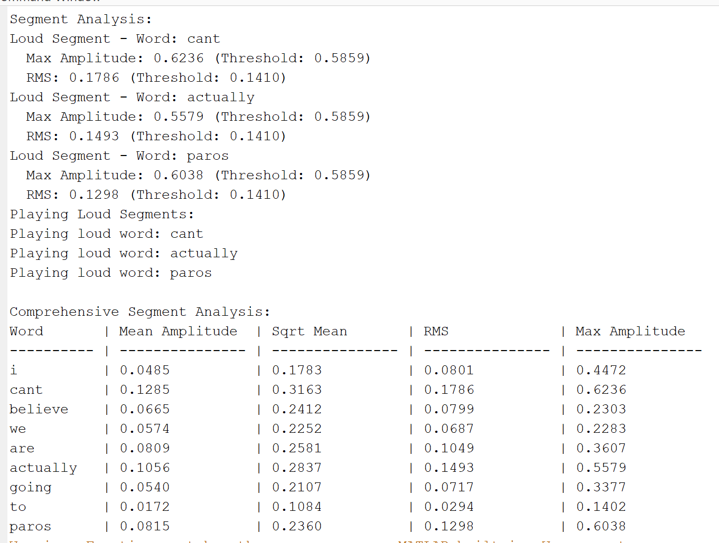

Slide 40
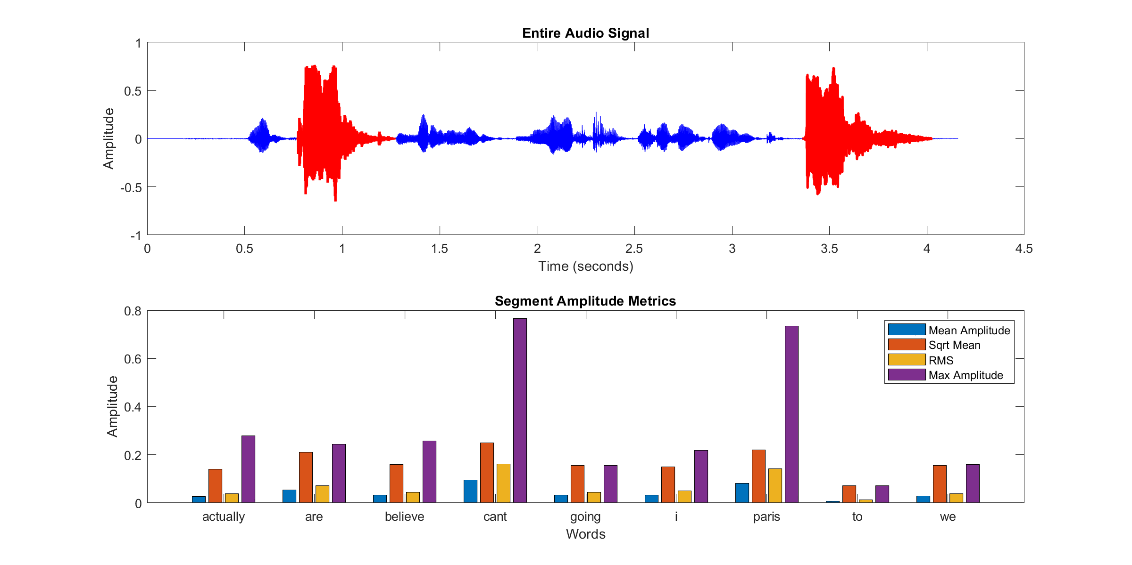

Slide 41
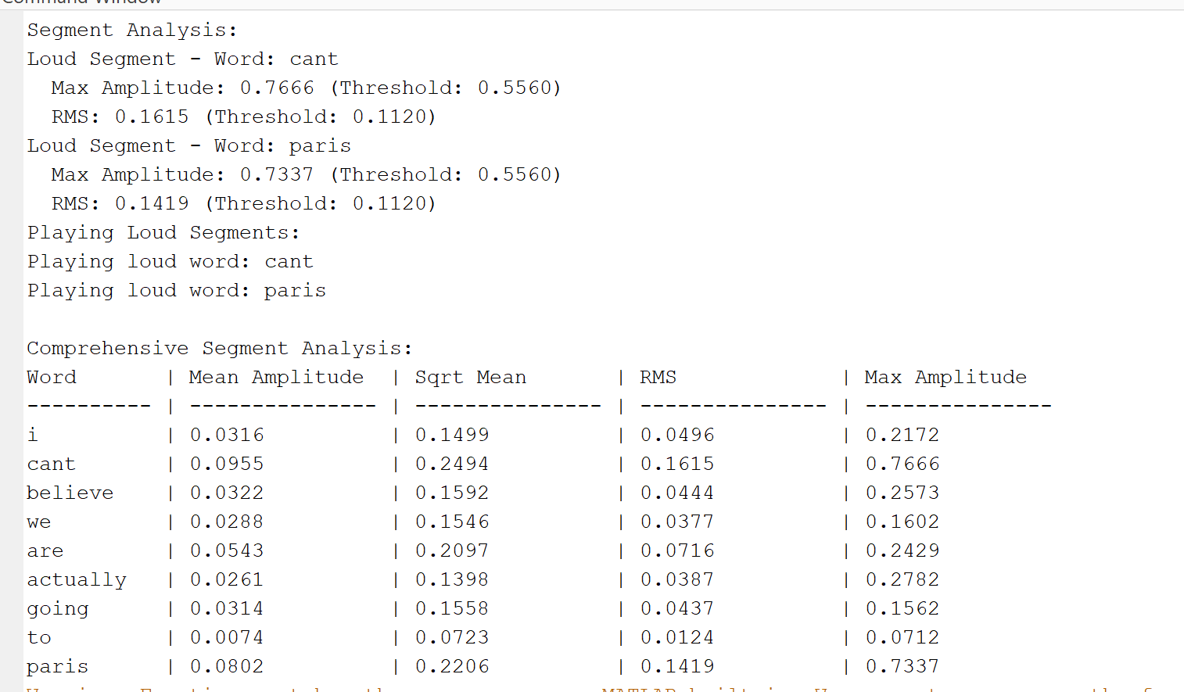

Slide 42
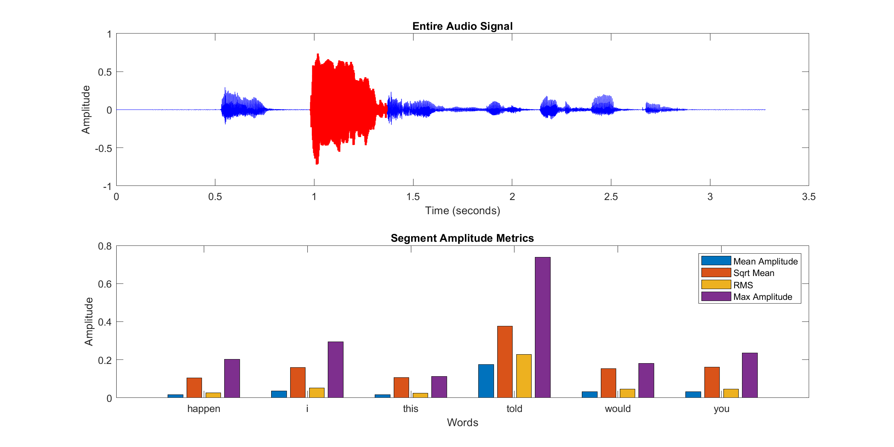

Slide 43
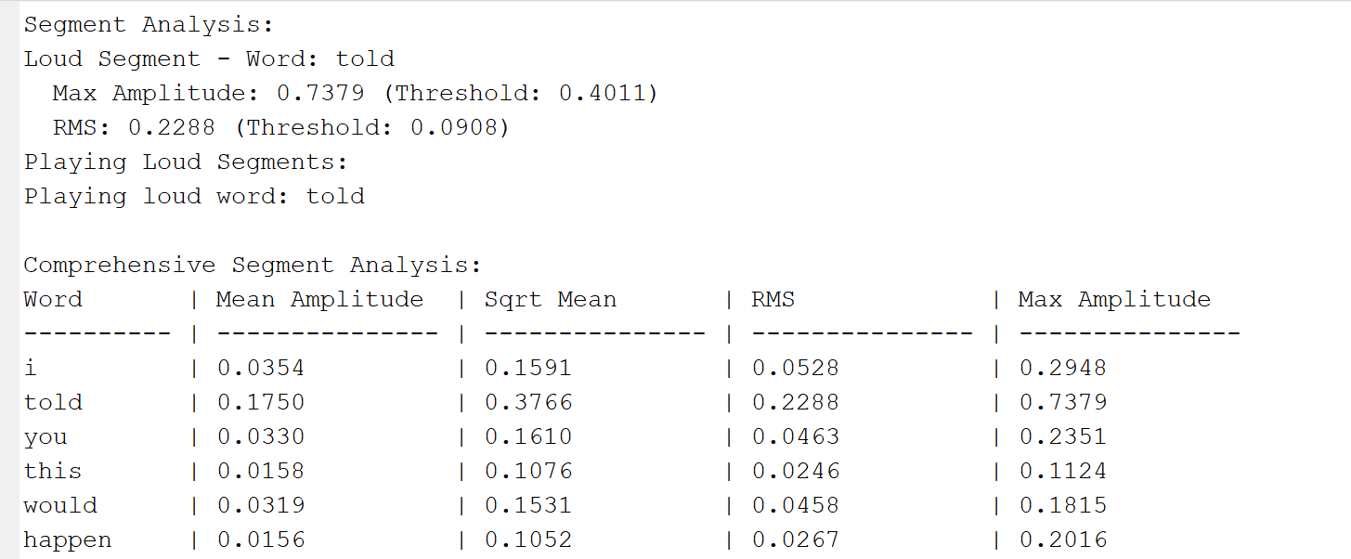

Slide 44
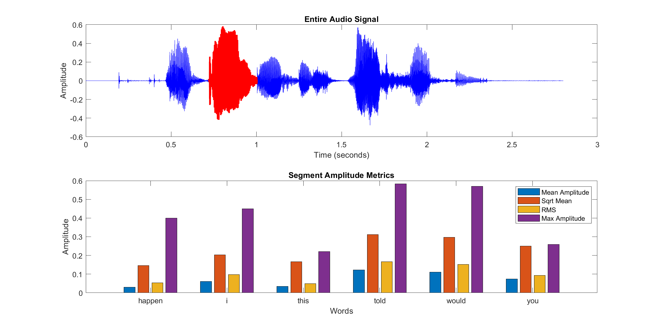

Slide 45
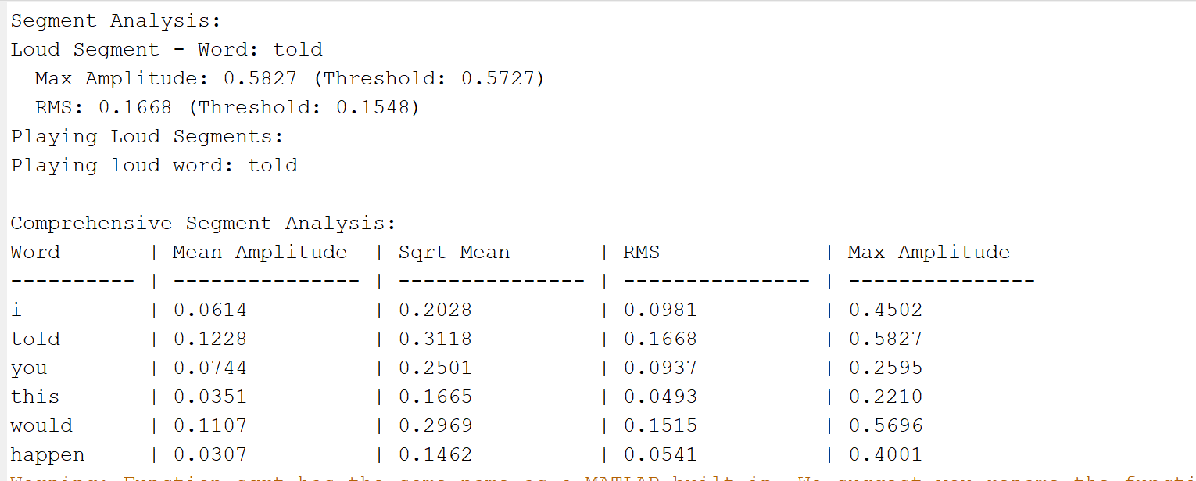

Slide 46


Slide 47


Slide 48


Slide 49


Slide 50


Slide 51


Slide 52
TASK-2
Input Audio: Audio file is read and converted to mono (if stereo).
Segmentation: Dividing audio into smaller segments (based on time stamps).
Loudness Metrics: Calculating various amplitude metrics for each segment.
Loud Segment Detection: Identifying segments with loudness above specific thresholds (max amplitude and RMS).

Slide 53
Data Preparation, Segmentation, and Loudness Metrics Calculation
Data Preparation: Convert audio to mono and segment into frames using short-term energy.
Segmentation: Use energy thresholding to detect speech frames.
Loudness Metrics: For each speech segment, compute:
Mean Amplitude: Average absolute value.
RMS (Root Mean Square): A measure of the signal's energy.
Max Amplitude: Maximum absolute value.

Slide 54


Slide 55
Playback of loud segments
Loud segments were successfully identified and highlighted in the waveform.
Amplitude metrics such as Mean, RMS, and Max amplitude were calculated for each word.
Thresholds were applied to detect the loudest speech regions effectively.

Slide 56


Slide 57


Slide 58


Slide 59


Slide 60
THANK YOU

